Slide 1


NLP Chatbot Development using Dialogflow

Slide 2
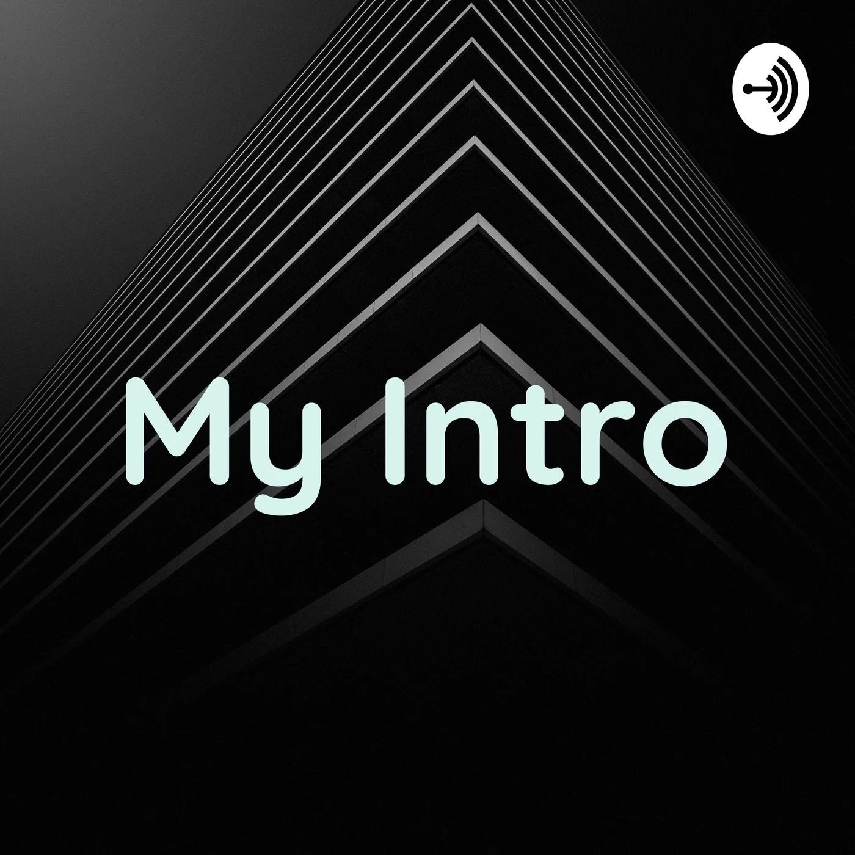
Muhammad Abdullah BC210412114 BS Software Engginering Virtual University of Pakistan

Slide 3
Introduction
• Chatbots are revolutionizing customer service.
• NLP enables bots to understand human language.
• Dialogflow offers powerful tools for chatbot development.
• This project automates restaurant interactions through a chatbot.

Slide 4

Problem Statement
• Manual customer handling leads to inefficiencies.
• Repetitive queries overload staff.
• Customers demand instant and 24/7 responses.
• Solution: Develop an intelligent chatbot using Dialogflow.

Slide 5
Objectives
• Design and implement a user-friendly restaurant chatbot.
• Automate tasks like order taking, reservations, and FAQs.
• Ensure multi-platform support (web, mobile).
• Use NLP to enhance conversational experience.

Slide 6
Implementation Overview
• Frontend form for chat interaction
• FastAPI backend processes requests
• Dialogflow handles intent recognition
• MySQL stores user queries and orders

Slide 7
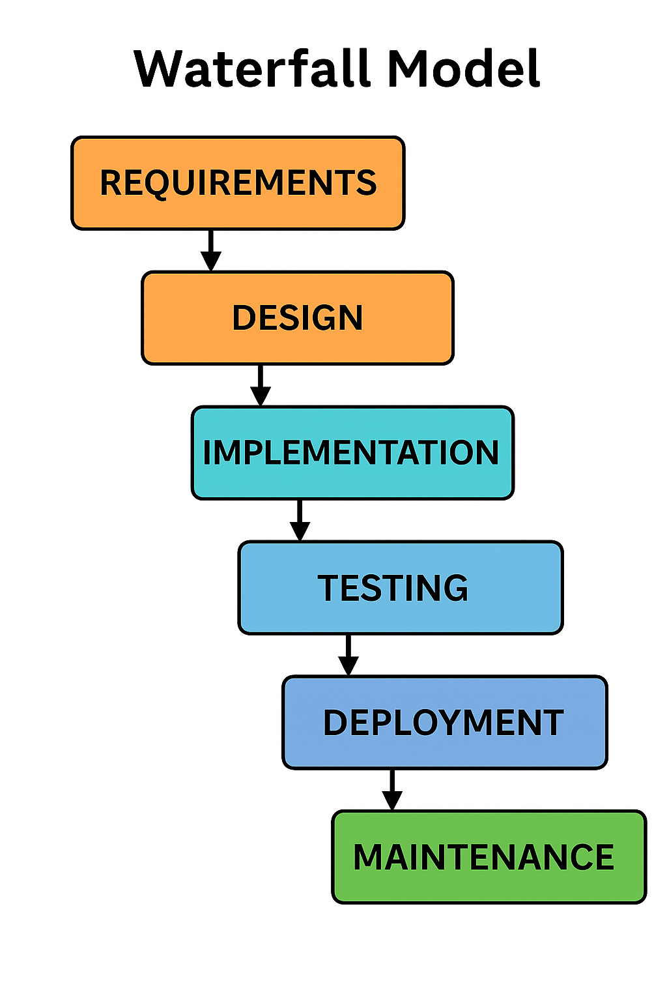
Diagram of Process Model

Slide 8
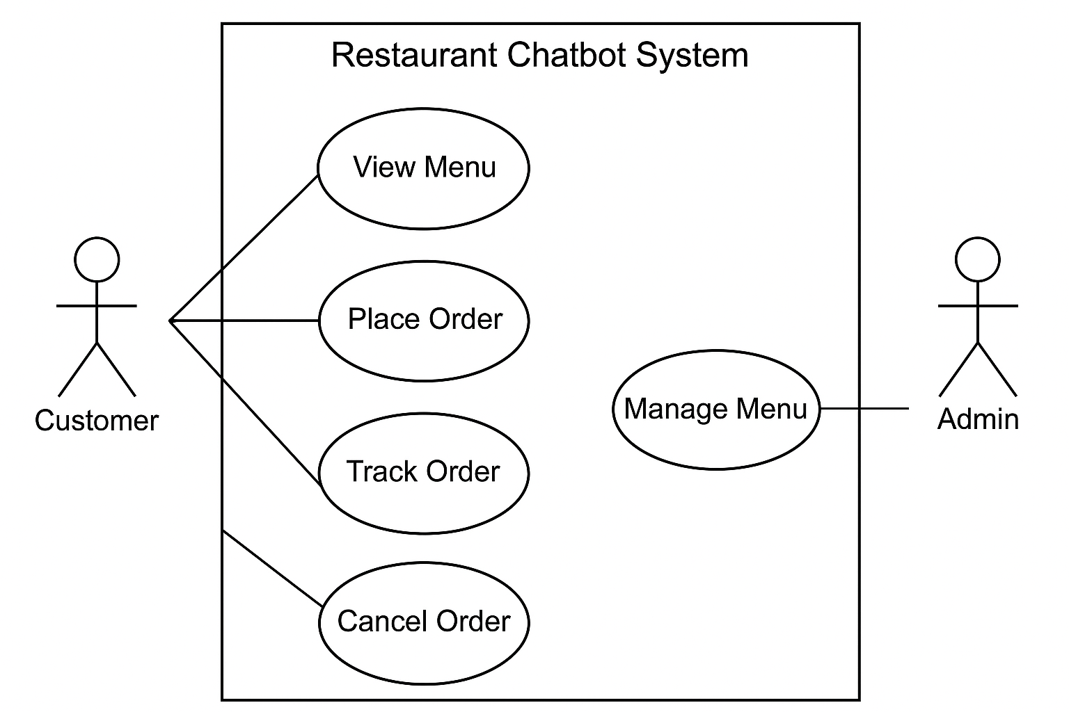
Use Case Diagram

Slide 9
Business Rules Catalog
• Menu Display: Chatbot shows menu with names, descriptions, and prices.
• Order Placement: Customers can place food orders via conversation.
• Order Tracking: Users can track order status (e.g., pending, delivered).
• Order Modification: Orders can be canceled within 5 minutes if not prepared.
• User Authentication: Account creation and login are required to order.
• Admin Control: Admin can add, update, or remove menu items.
• Order Storage: All orders are saved with unique IDs and timestamps.
• Response Time: Chatbot responds within 2 seconds.
• Input Validation: User inputs are validated before processing.
• Session Management: Chat maintains continuity for multi-step orders.

Slide 10
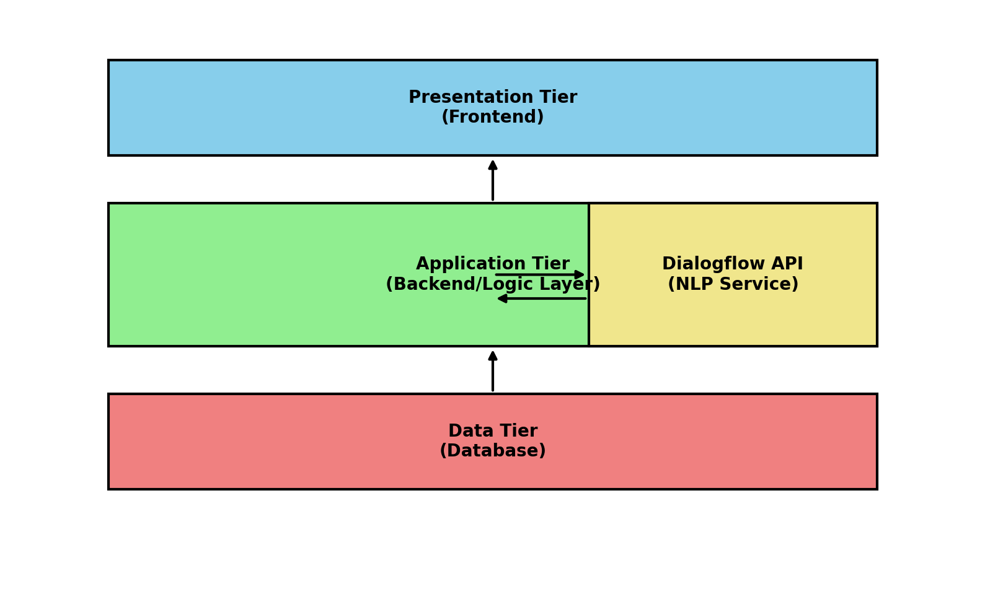
System Architecture

Slide 11
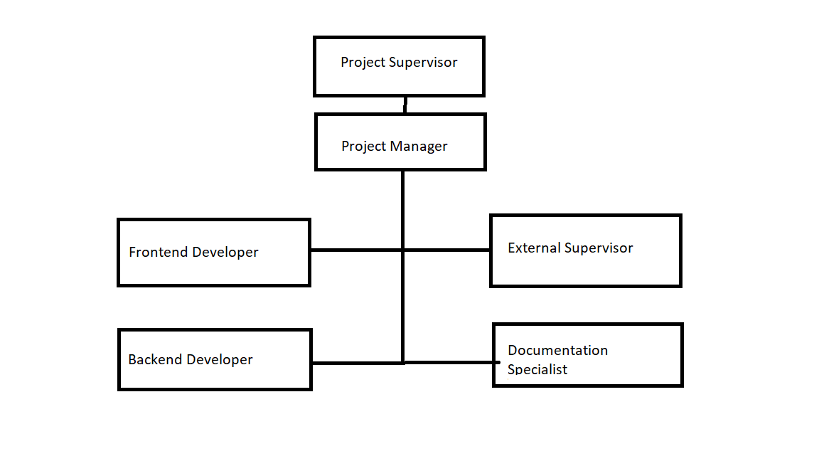
Team Structure

Slide 12
Key Responsibilities
Project Manager: Oversees all activities, ensures deadlines are met, coordinates with supervisor.
Frontend Developer: Designs and builds the user interface (HTML, CSS, JS).
Backend Developer: Develops APIs, integrates chatbot logic, manages database (FastAPI, MySQL).
Documentation Specialist: Prepares reports, SRS, presentations.
External Supervisor: Provides industry feedback, reviews work.
Project Supervisor: Guides project from academic perspective.

Slide 13
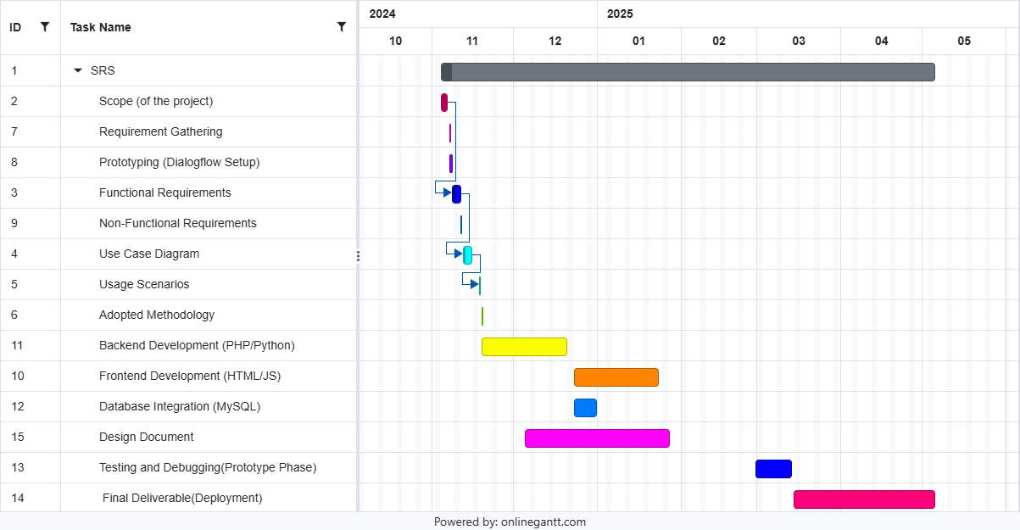
Project Schedule

Slide 14

Sequence Diagrams
Here are some core sequence diagrams

Slide 15
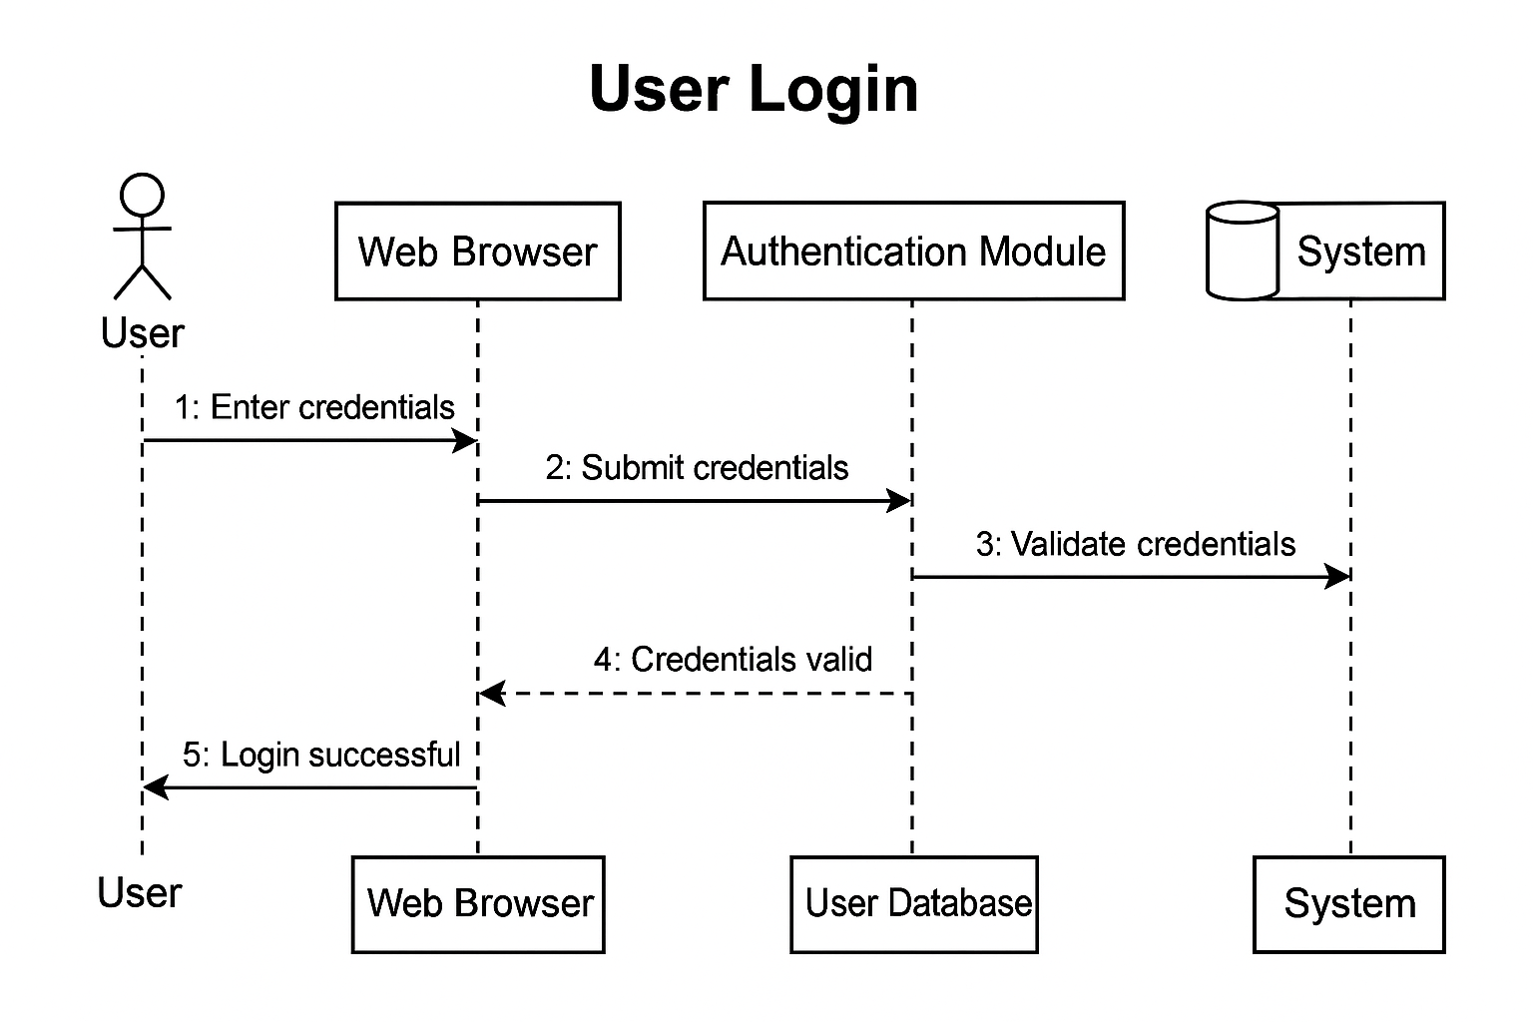
User Login Sequence Diagram

Slide 16
User Login Sequence Diagram

Slide 17
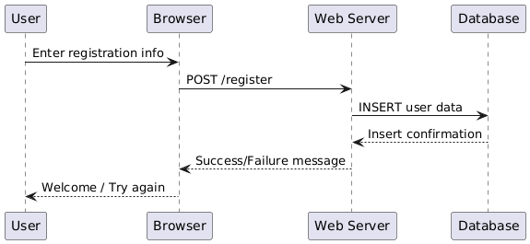
User Registration Sequence Diagram

Slide 18
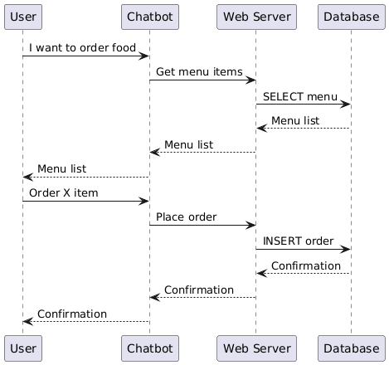
Place Food Order Sequence Diagram

Slide 19
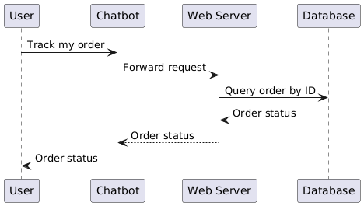
Track Order Status Sequence Diagram

Slide 20
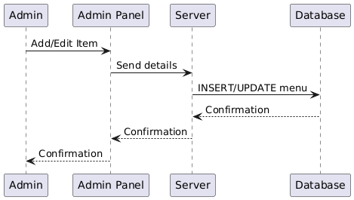
Admin Add/Edit Menu Items Sequence Diagram

Slide 21
Logical Model/Class Diagram

Slide 22
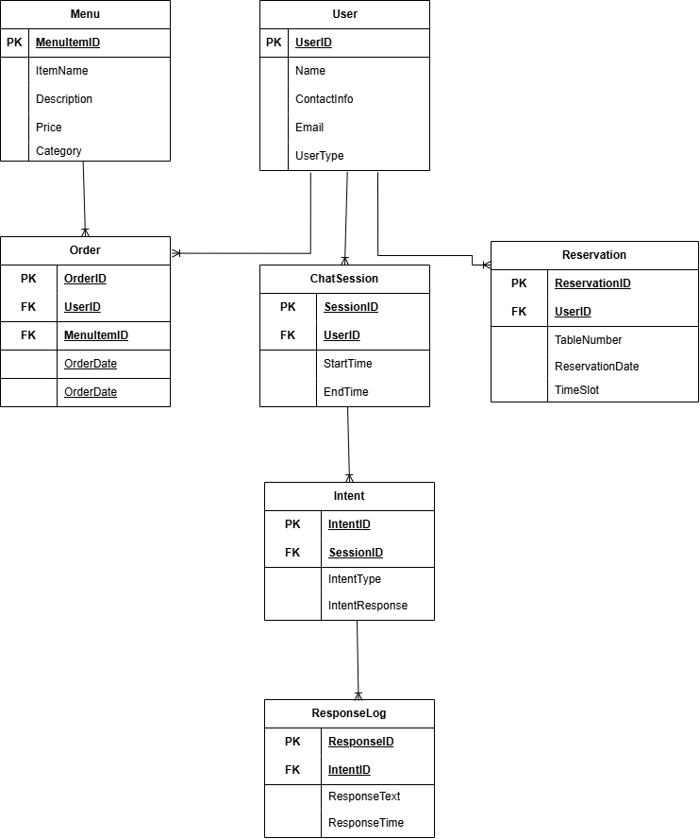
Entity-Relationship Diagram

Slide 23
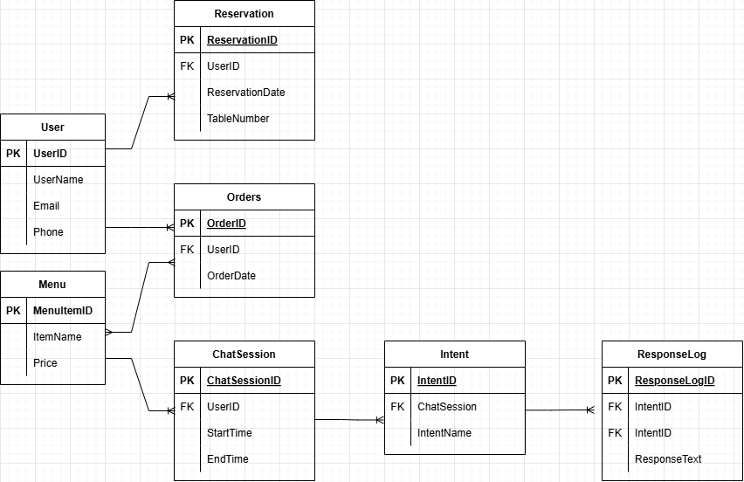
Database Diagram

Slide 24
User Interfaces
screen shots of GUI application.
Chatbot responding to queries and taking orders.

Slide 25
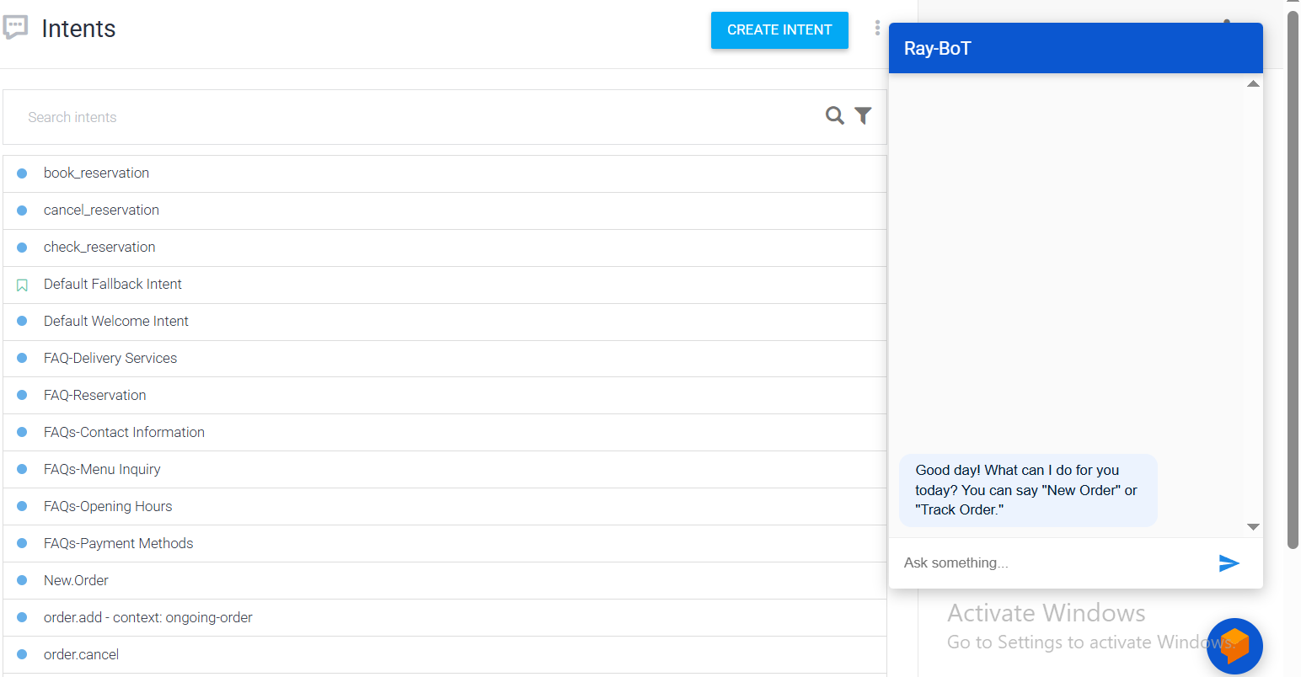
DialogFlow

Slide 26
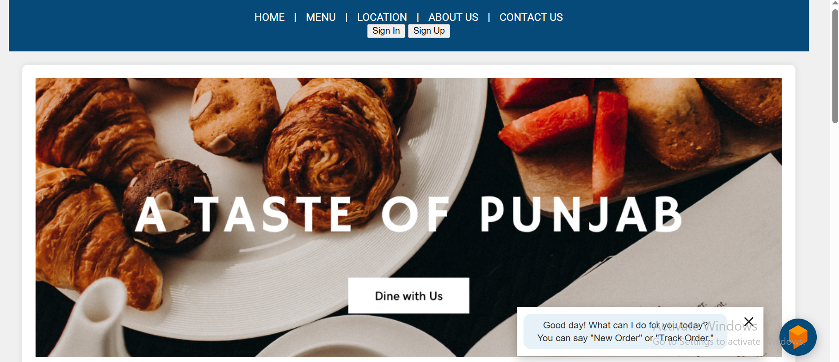
Website Frontend

Slide 27
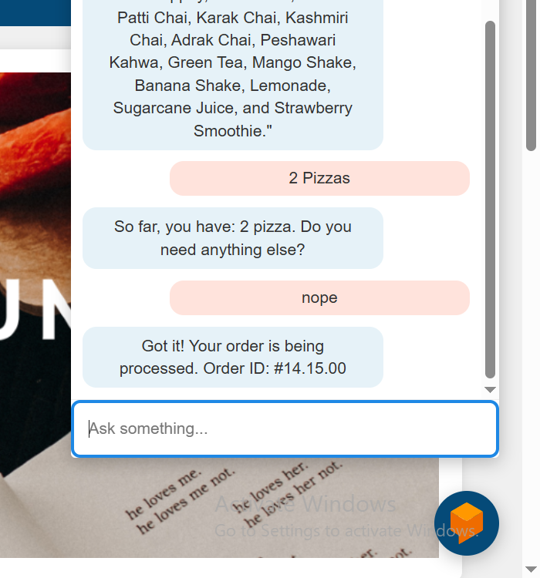
Chatbot

Slide 28
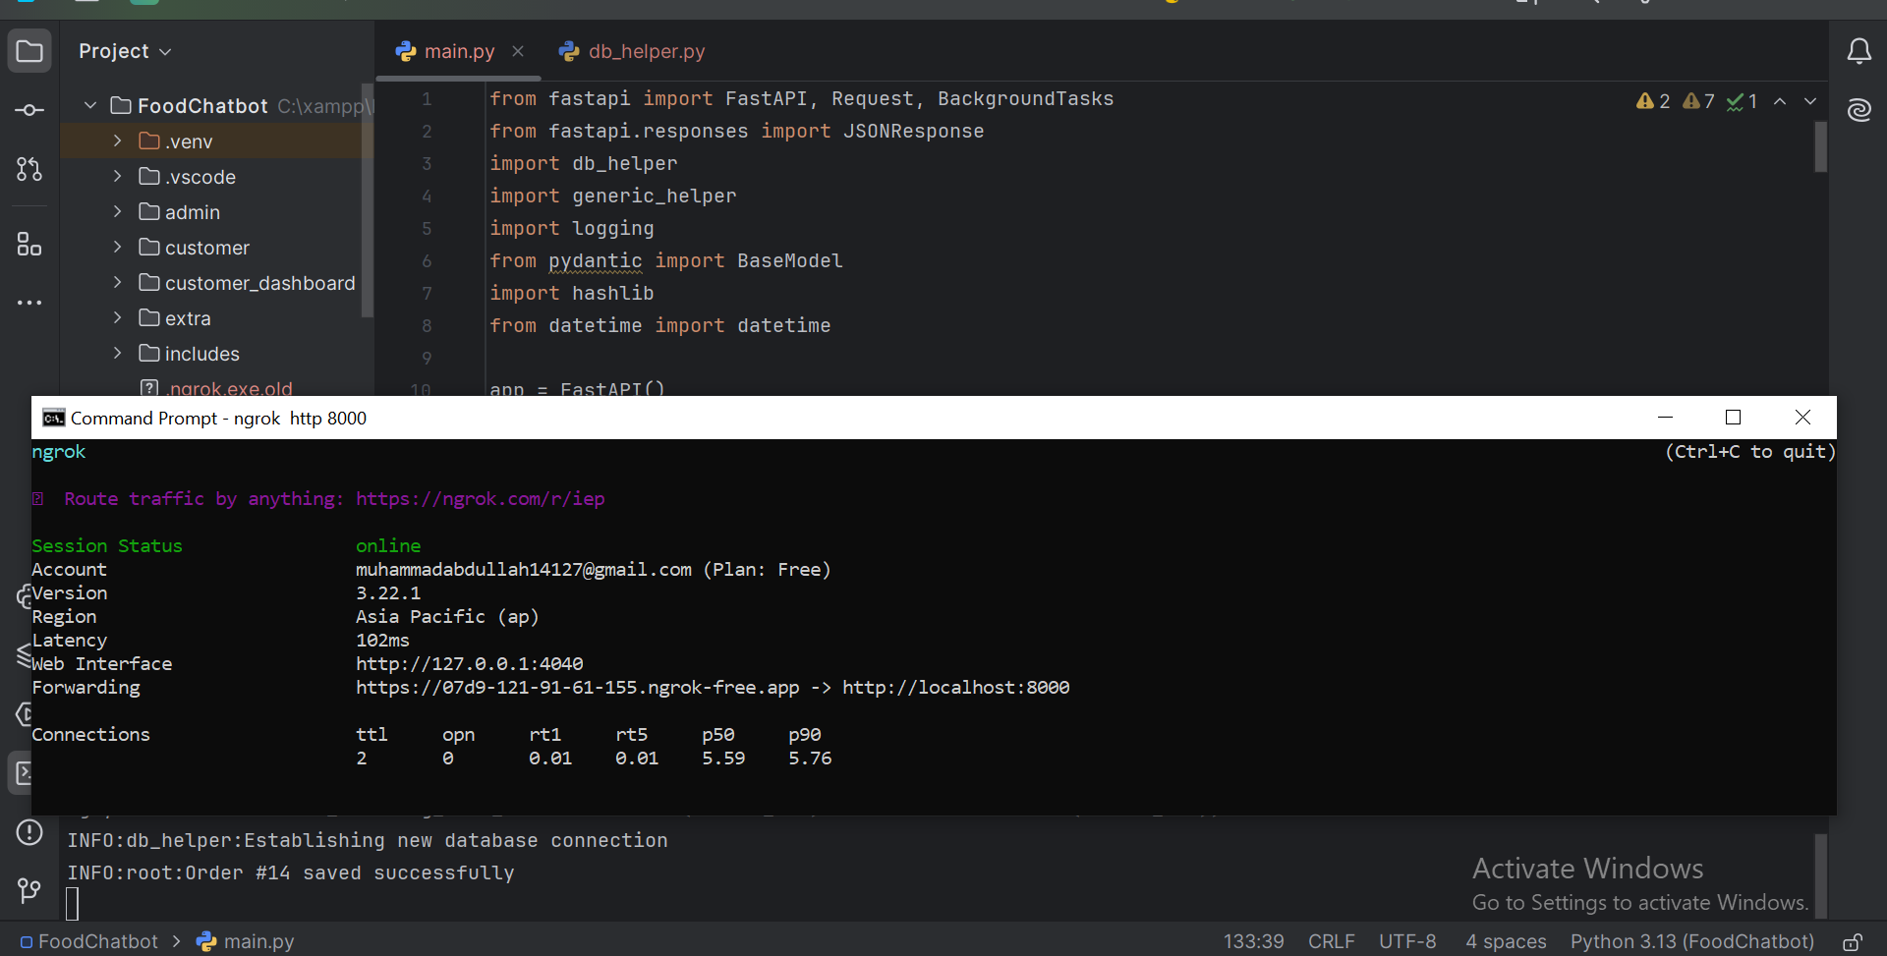
Back-End

Slide 29
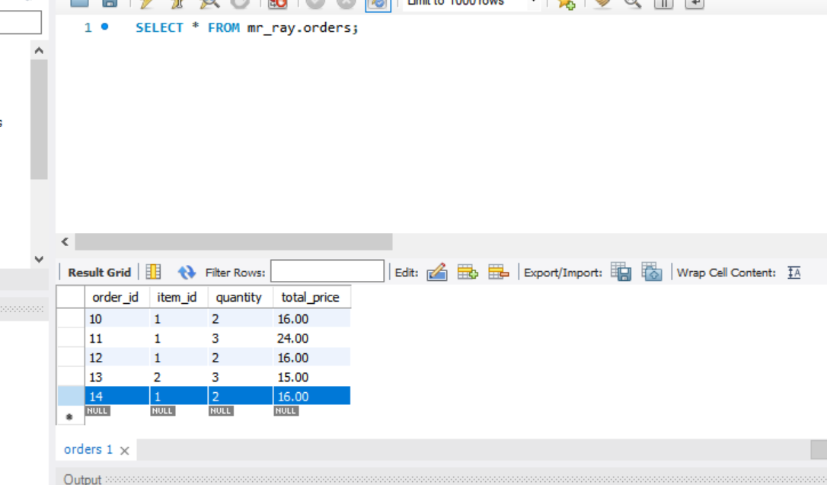
Database

Slide 30
Tools & Technologies
• Google Dialogflow (NLP Platform)
• Python + FastAPI (Backend)
• HTML/CSS/JS (Frontend)
• MySQL (Database)
• VS Code, SQL Workbench, PyCharm (Development Tools)

Slide 31
Conclusion
• Chatbots improve customer service efficiency.
• Dialogflow simplifies NLP-based bot development.
• Project enhances user engagement for restaurants.
• Future scope includes voice support and analytics.

Slide 32

Thank you
Muhammad Abdullah BC@210412114
bc210412114mab@vu.edu.pk
Virtual University Of Pakistan

